Slide 1



Airborne dust identification from space: a new, MSG/SEVIRI-based method for air quality assessment Prof. Valerio Tramutoli
^{valerio.tramutoli@unibas.it}
University of Basilicata, School of Engineering, Potenza, Italy

Slide 2

Particular matter PM₁₀
ANTHROPOGENIC
SOURCES
NATURAL
High PM₁₀ concentrations…
HUMAN HEALTH
…are responsible for 6% of total mortality
… cause damage to the cardiovascular and respiratory systems
IMPACTS
DIRECT
…impact on reflection and absorption of solar and IR radiation in the atmosphere
CLIMATE
INDIRECT
…can alter cloud features by acting as condensation nuclei

Slide 3
DIRECTIVE 2008/50/EC OF THE EUROPEAN PARLIAMENT AND OF THE COUNCIL (21/05/2008)
on ambient air quality and cleaner air for Europe
ANNEX XI - LIMIT VALUES FOR THE PROTECTION OF HUMAN HEALTH
PM10 | Averaging Period | Limit value
 | One day | 50 μg/m³, not to be exceeded more than 35 times a calendar year
Local authority actions (e.g. traffic restrictions)
Article 20 – CONTRIBUTIONS FROM NATURAL SOURCES*
Paragraph 2
Where the Commission has been informed of an exceedance attributable to natural sources in accordance with paragraph 1, that excedance shall not be considered as an exceedance for the purposes of this Directive.
* Article 2 – Paragraph: 15 Contributions from natural sources’ shall mean emissions of pollutants not caused directly or indirectly by human activities, including natural events such as volcanic eruptions, seismic activities, geothermal activities, wild-land fires, high-wind events, sea sprays or the atmospheric re-suspension or transport of natural particles from dry regions

Slide 4
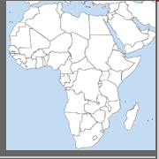
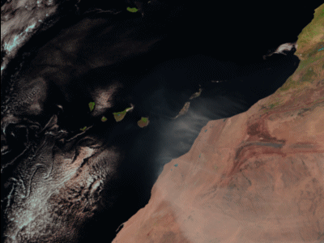
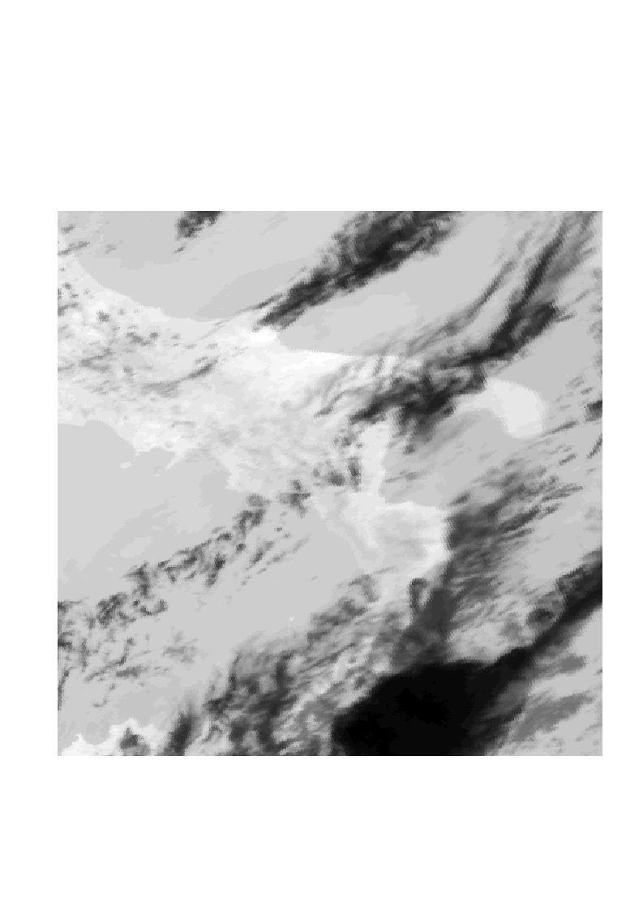
Dust Storm Spectral Signatures
Usually colder than background surfaces
(in the Thermal InfraRed .TIR)
Highly reflecting
Solar radiation in the VISible
easier to detect over the sea than over land (low contrast)
A Saharan Dust storm during
03/03/04 on a SEVIRI image
SAND
STORM
Like to meteorological
clouds !
METEO
CLOUDS
SEVIRI RGB

Slide 5
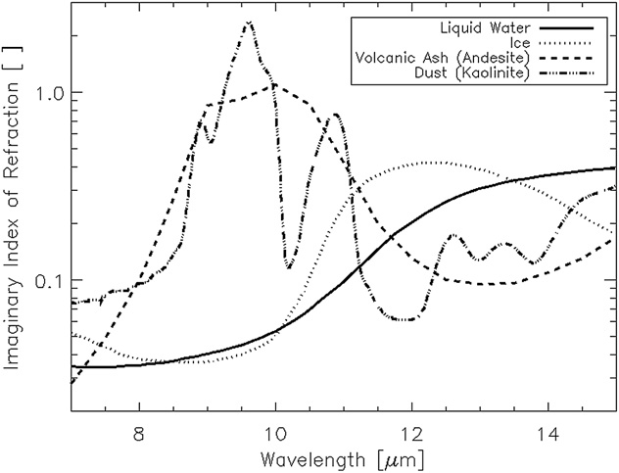
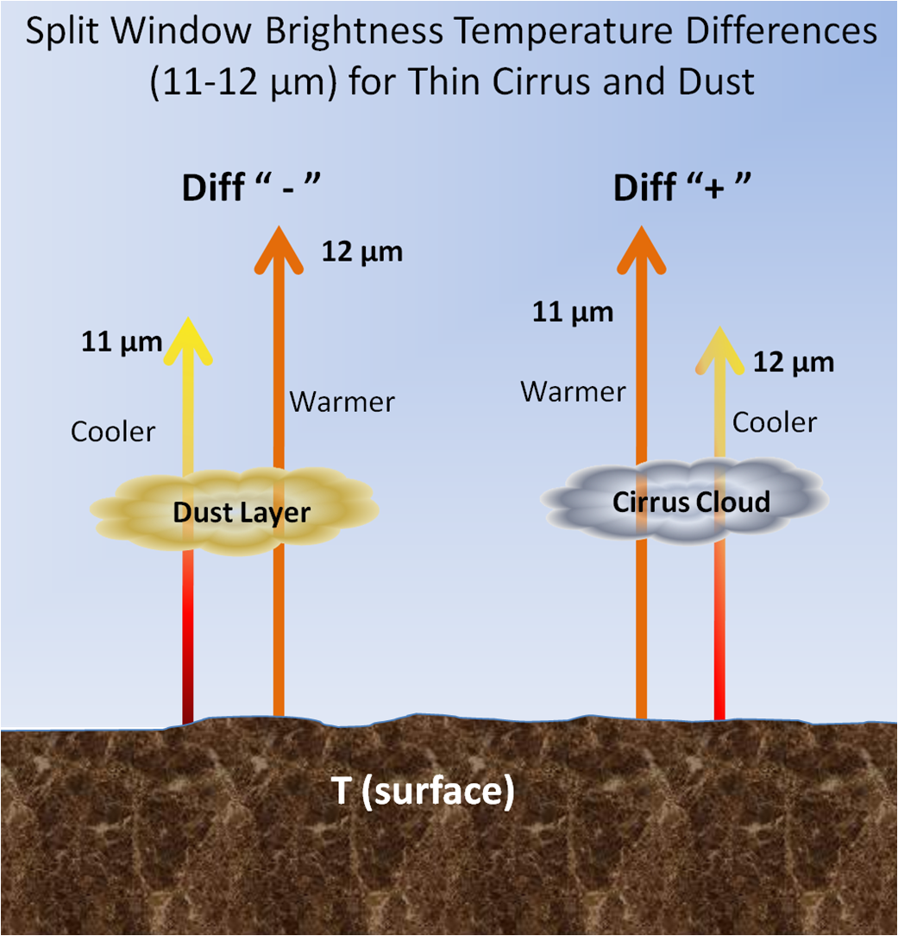
Discriminating meteo from dust clouds the Split Window BTD method (e.g. Prata. 1989, Gu et al., 2003; Luo et al., 2003)
Dust → T_{11μ} - T_{12μ}< 0
Clouds → T_{11μ} - T_{12μ}> 0
A Saharan Dust storm during 03/03/04 on a SEVIRI image
ΔT_{11μ-12μ}< 0
T_{11μ} - T_{12μ}< 0
T_{11μ} - T_{12μ}> 0
ΔT_{11μ-12μ}> 0
Kerkmann Jochen (2010)

Slide 6
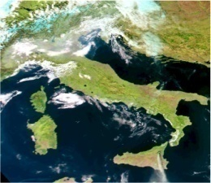
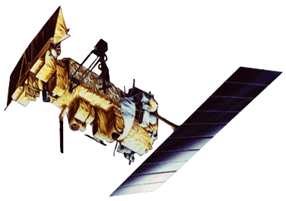
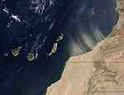
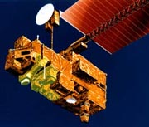
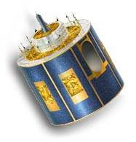
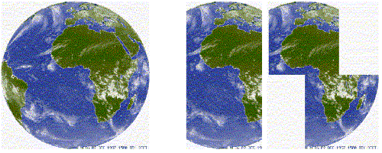
Main meteorological (high repetition) satellite sensors with split window capabilities
Sensor | Spatial Resolution | Temporal Resolution | Satellite | Available since
AVHRR (Global) | 1,1 Km | 6 h | NOAA/ MetOp | 1978
MODIS (Global) | 0,25 – 1 Km | 12 h | EOS | 1999
SEVIRI (Europe & Africa) Global by Geosttionary Constellation | 1 - 3 Km | 15 min. | MSG | 2003
for timely detection of signal variations

Slide 7
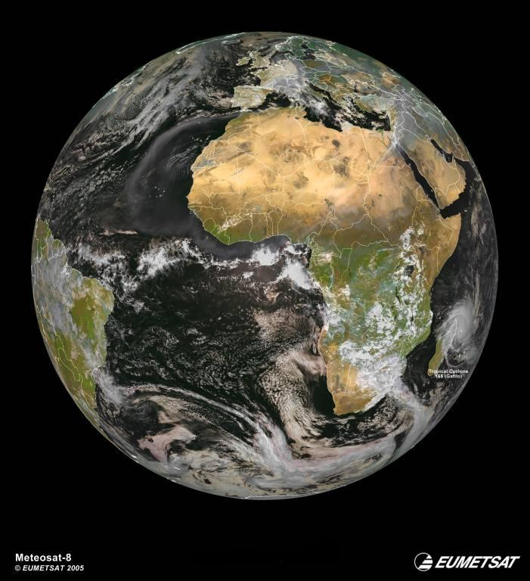
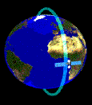
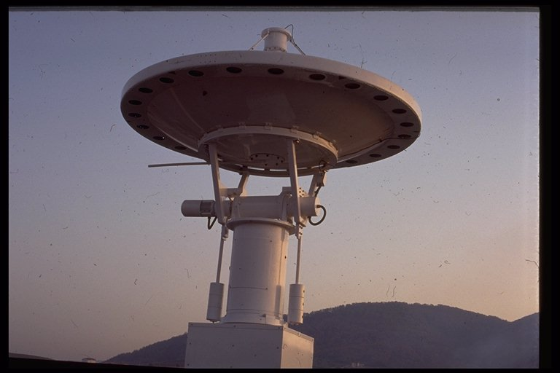
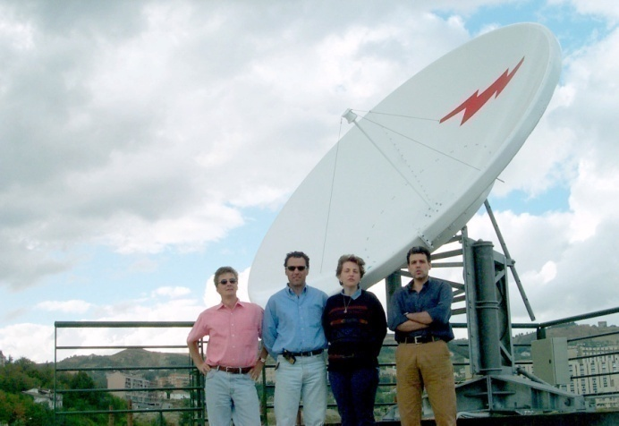

Space-Time coverage
NOAA & EOS receiving station
at IMAA
Since 1994
one image every
3-6 hours
Meteosat & MSG receiving station at UNIBAS
since 2000
one image every
5-15 minutes

Slide 8
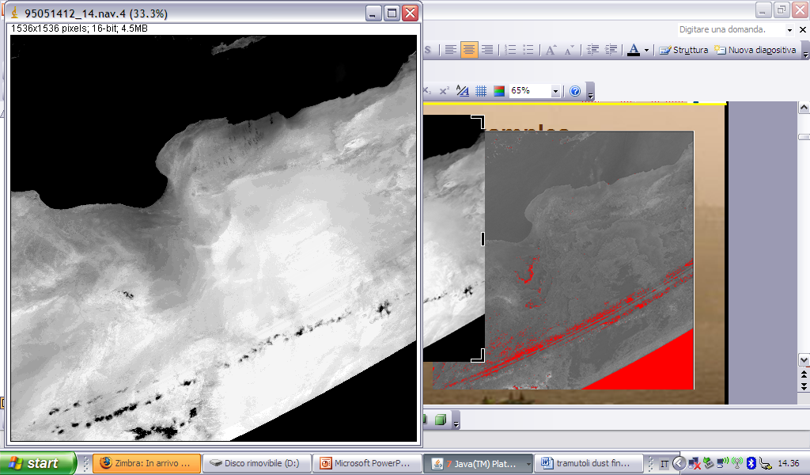
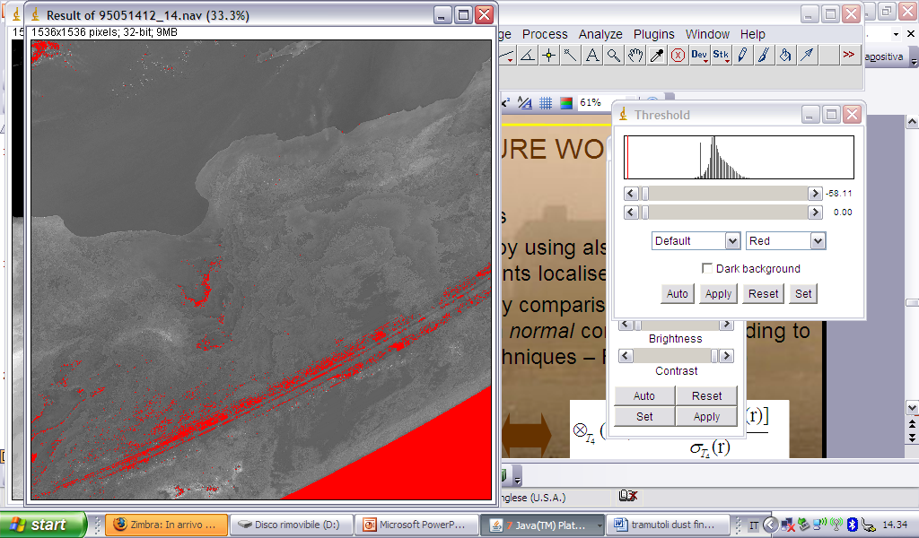
TRADITIONAL (FIXED THERSHOLD) METHODS FOR DUST-CLOUD DETECTION Split Window BTD method (e.g. Prata. 1989, Gu et al., 2003; Luo et al., 2003) Main issues: false positives
Prata (1989)
T_{11μ} – T_{12μ} < 0
False Positive
14/05/1995: no dust storm present over the scene
Result of a traditional “split-window”-based method

Slide 9
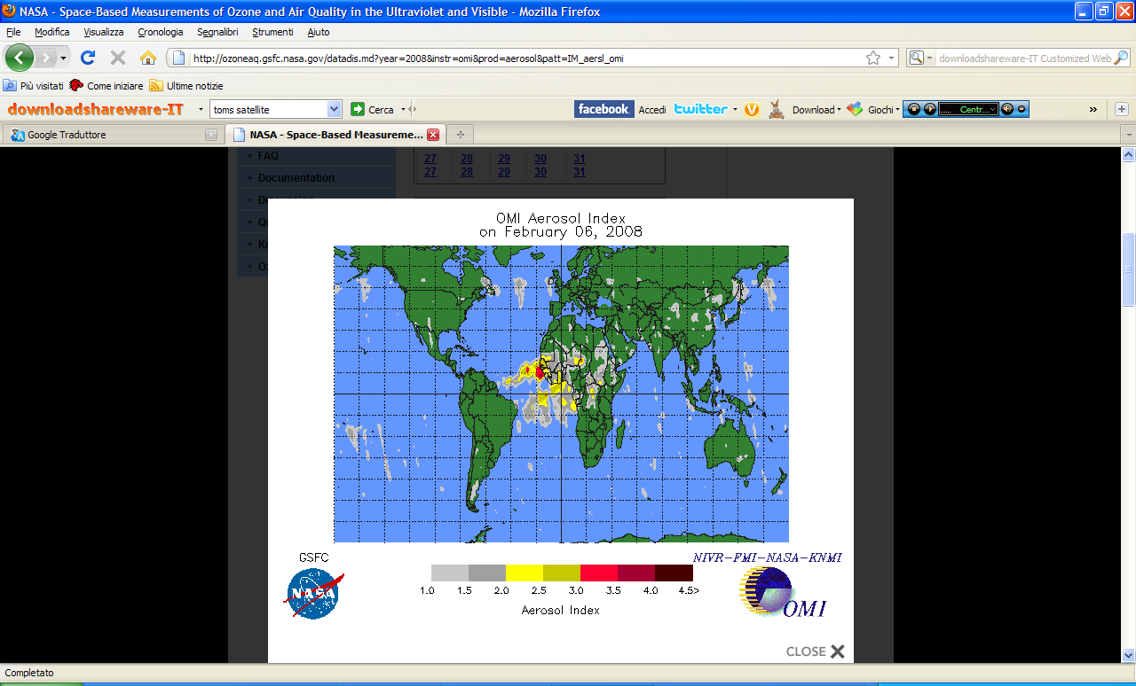
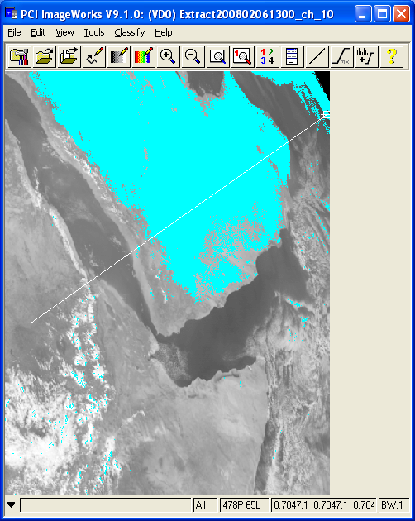
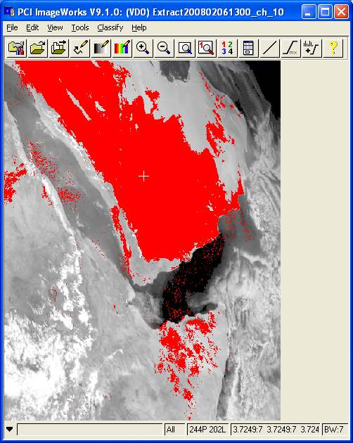
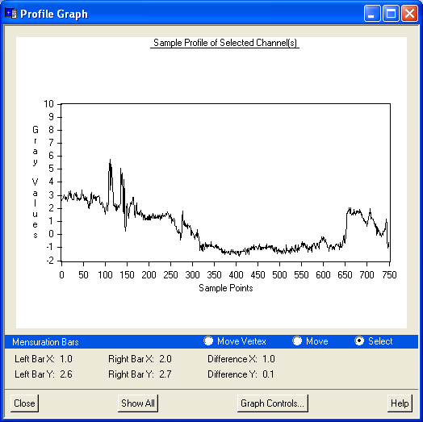
TRADITIONAL (FIXED THERSHOLD) METHODS FOR DUST-CLOUD DETECTION Split Window BTD method (e.g. Prata. 1989, Gu et al., 2003; Luo et al., 2003) Main issues: false positives
SEVIRI 06/02/2008_h 13 UTC
(Prata, 1989)
(Luo, 2003)
B
B
B
SEVIRI 0,6 μm
A
SEVIRI 0,6 μm
A
A
ΔT (11μm -12μm) < 0
ΔT (11μm -12μm) <1
ftp://toms.gsfc.nasa.gov/pub/omi/images/aerosol/Y2008/
ΔT(k)
AA
Luo (2003) threshold
BB
Prata (1989) threshold
N°pixel

Slide 10
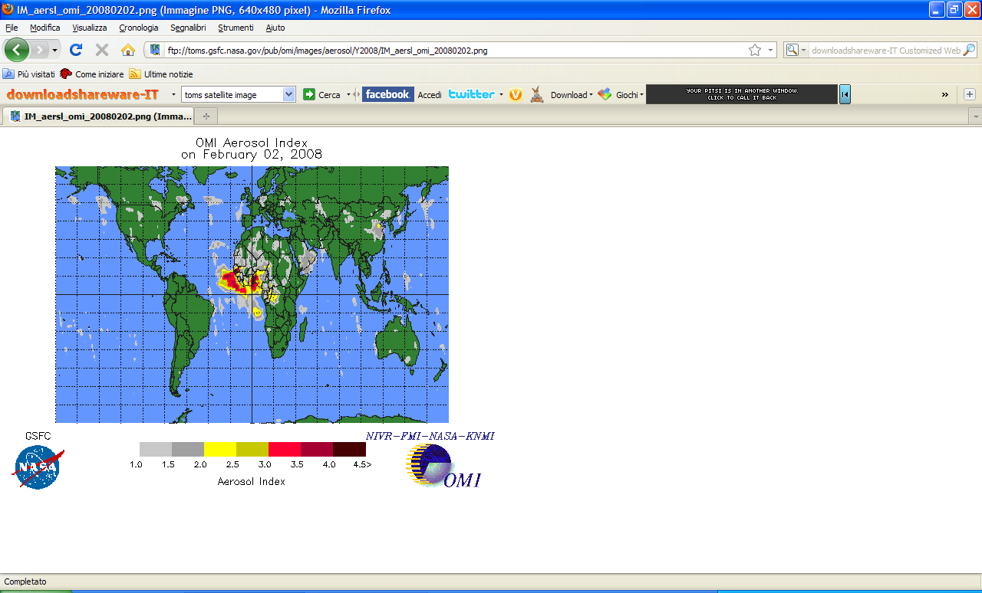
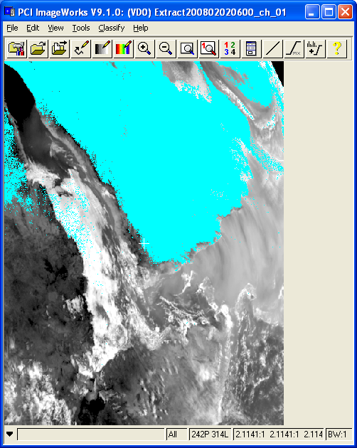
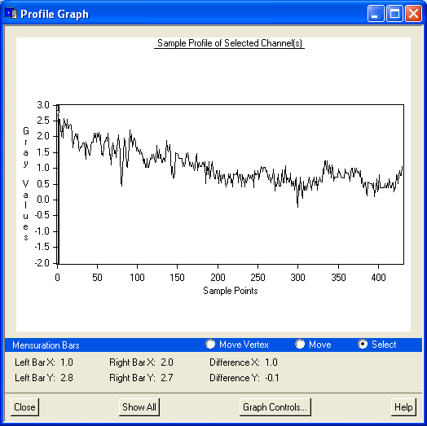
TRADITIONAL (FIXED THERSHOLD) METHODS FOR DUST-CLOUD DETECTION Split Window BTD method (e.g. Prata. 1989, Gu et al., 2003; Luo et al., 2003) Main issues: missed detections
SEVIRI 02/02/2008_h 06 UTC
(Prata, 1989)
B
SAND STORM
A
MISSED
SEVIRI 0,6 μm
ΔT (11μm -12μm) < 0
ΔT(k)
A
B
Prata (1989) threshold
pixel number

Slide 11
What does “anomaly” mean ? TRADITIONAL (FIXED THERSHOLD) METHODS
anomalies ?
Signal
Fixed threshold
tests
time or distance

Slide 12
What does “anomaly” mean ? lower thresholds increase sensitivity…
anomalies ?
but false alarms too !
Signal
Fixed threshold
tests
time or distance

Slide 13
What does “anomaly” mean ? higher thresholds increase reliability…
anomalies ?
but reduce sensitivity too
Signal
Fixed threshold
tests
time or distance

Slide 14
What does “anomaly” mean ?
anomalies ?
Signal at the sensor
V_{ref}(r)
±nσ(r)
Time or space

Slide 15
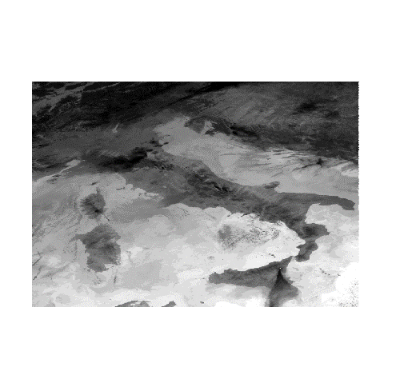
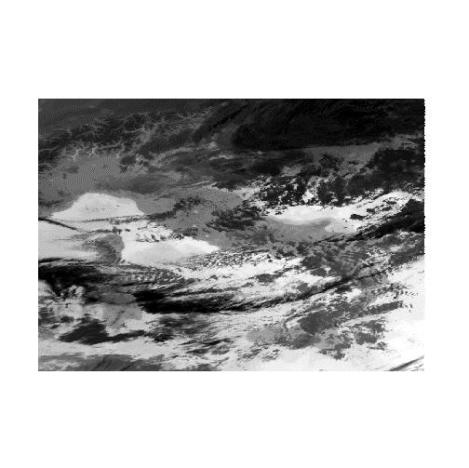
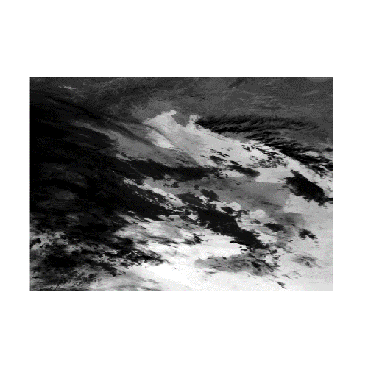
RST (Robust Satellite Technique) (formerly RAT: Robust AVHRR Techniques, V. Tramutoli, 1998, 2005)
1. Select an historical data-set V(r,t) as homogeneous as possible: same time of the day and period of the year (T-domain) in order to reduce natural/observational noise
Y
X
t

Slide 16
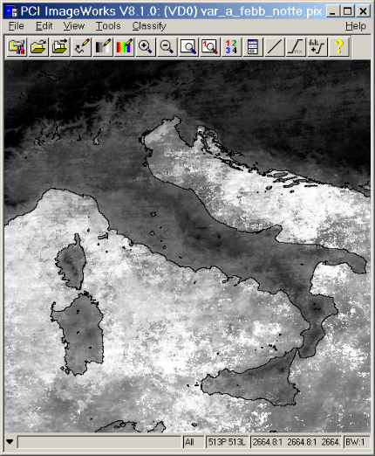
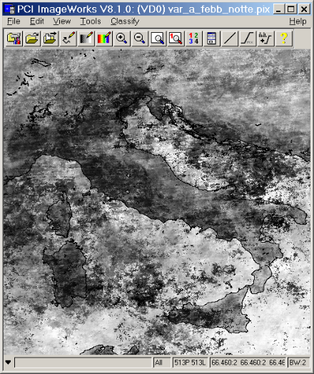
RST (Robust Satellite Technique)
1. Select an historical data-set V(r,t) as homogeneous as possible: same time of the day and period of the year (T-domain) in order to reduce natural/observational noise
2. Compute the unperturbed reference fields for the observable V(r,t)
V_{REF} (r) and σ_{V}(r)
Y
X
Febr-Nighttime
Febr-Nighttime
t

Slide 17
RST (Robust Satellite Technique)
1. Select an historical data-set V(r,t) as homogeneous as possible: same time of the day and period of the year (T-domain) in order to reduce natural/observational noise
2. Computing the unperturbed reference fields for the observable V(r,t)
3. Change - Detection at the time t by
V_{REF} (r) and σ_{V}(r)
Y
X
Febr-Nighttime
Febr-Nighttime
t
A.L.I.C.E.
(Absolutely Llocal Index of Change of the Environment)

Slide 18
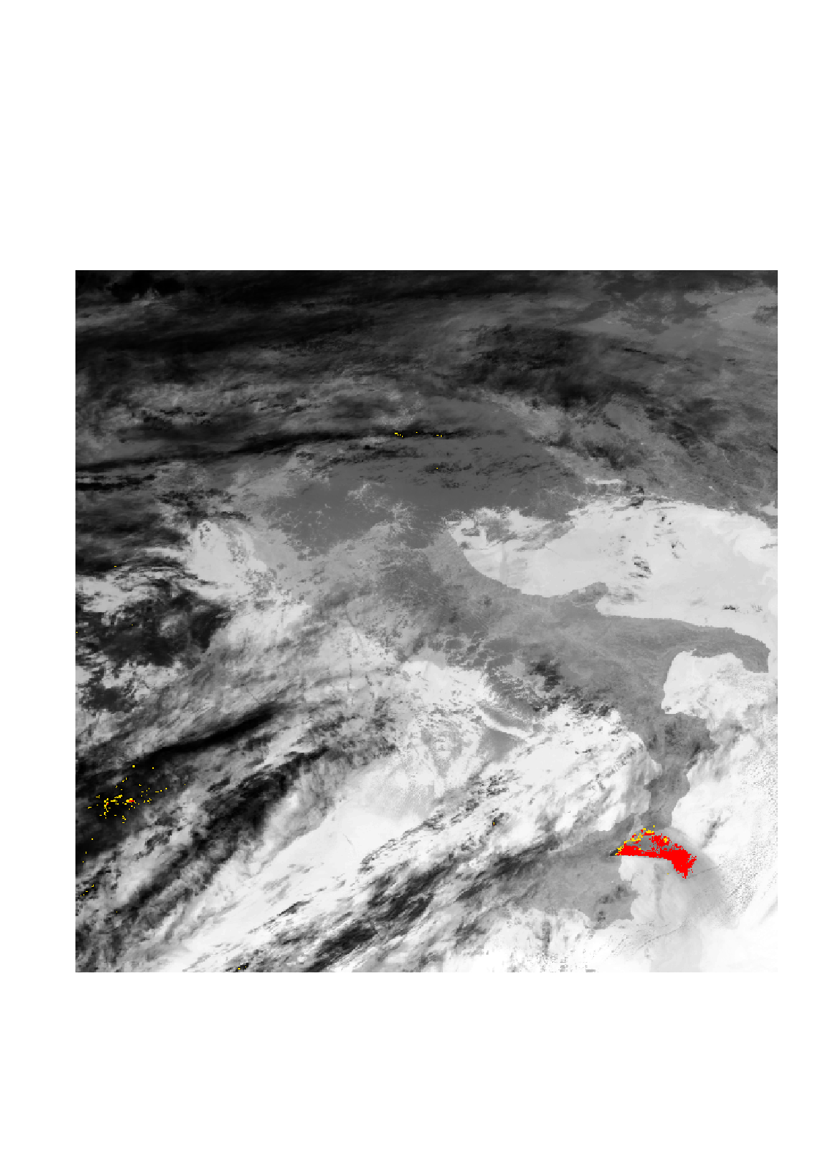
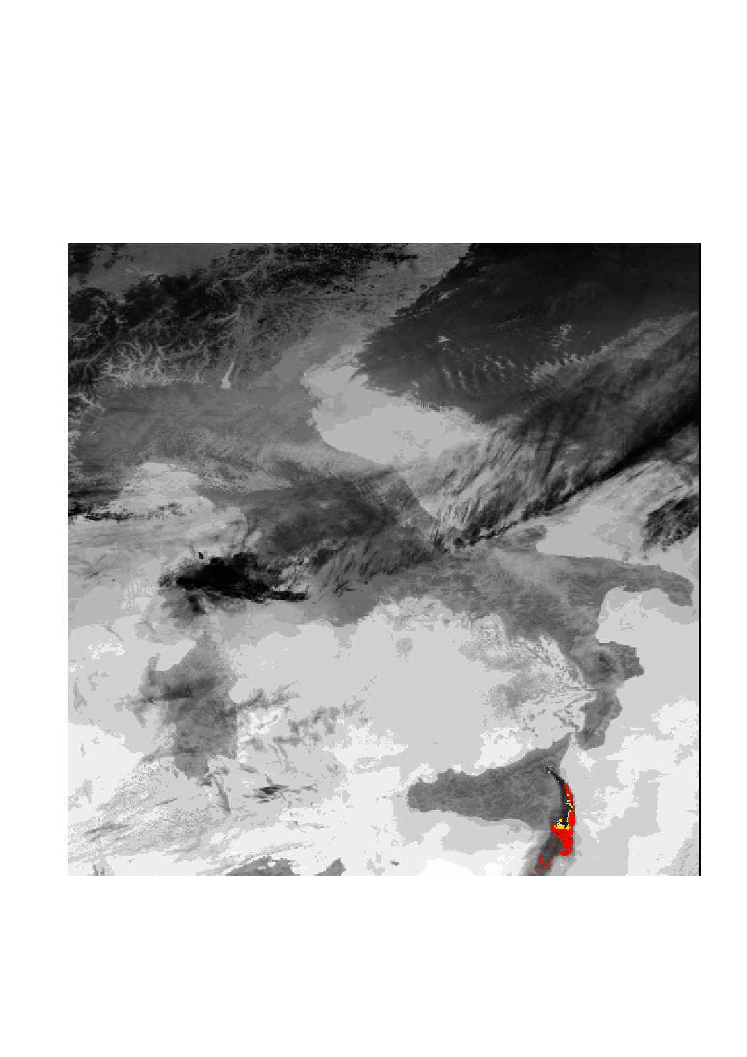
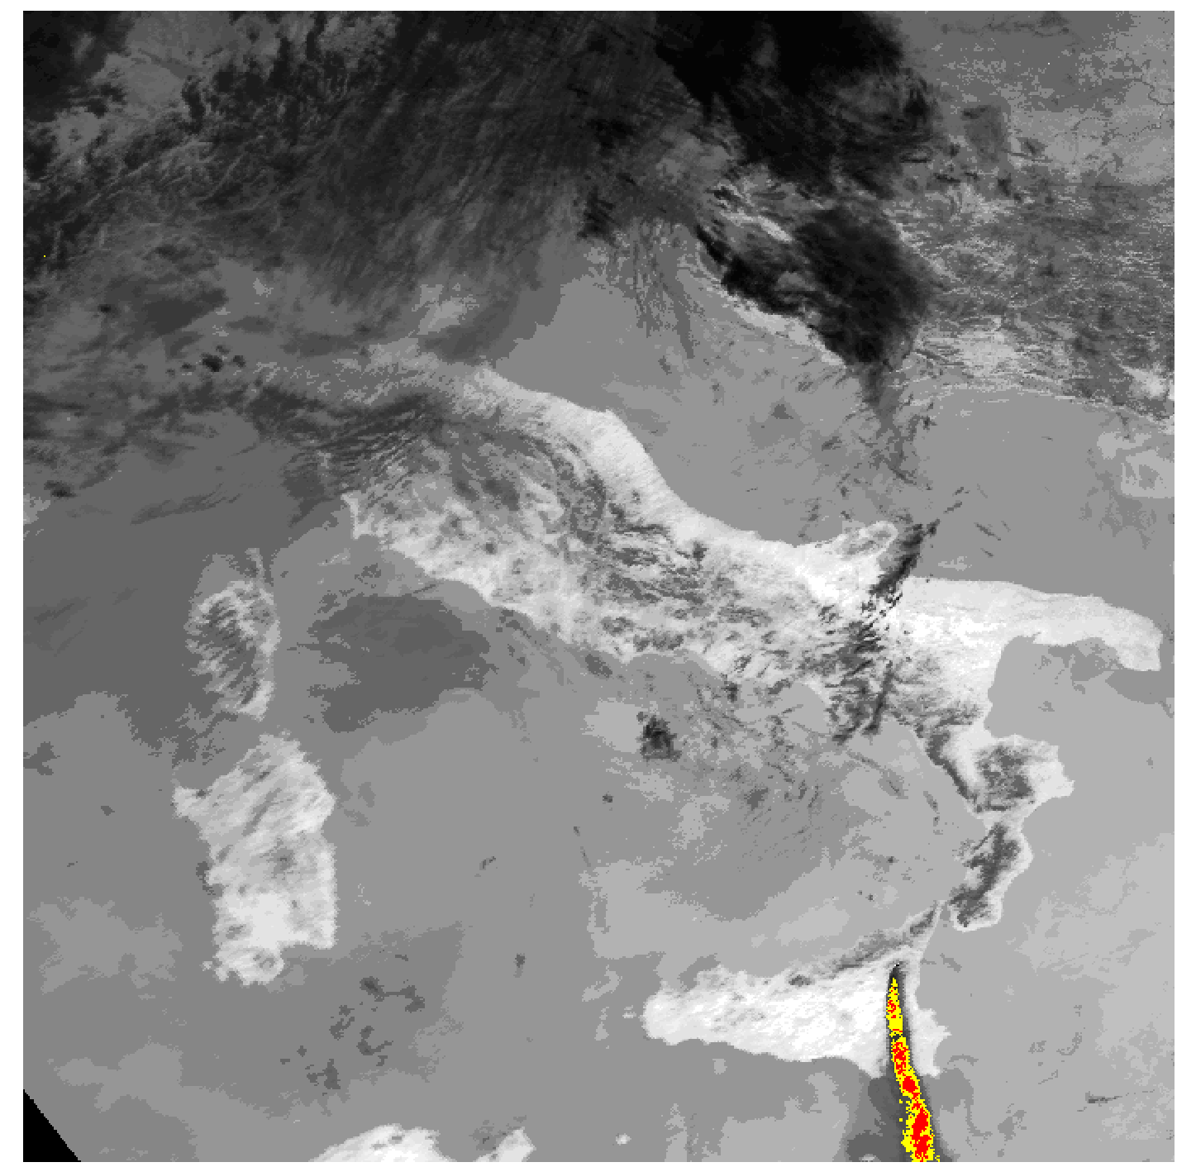
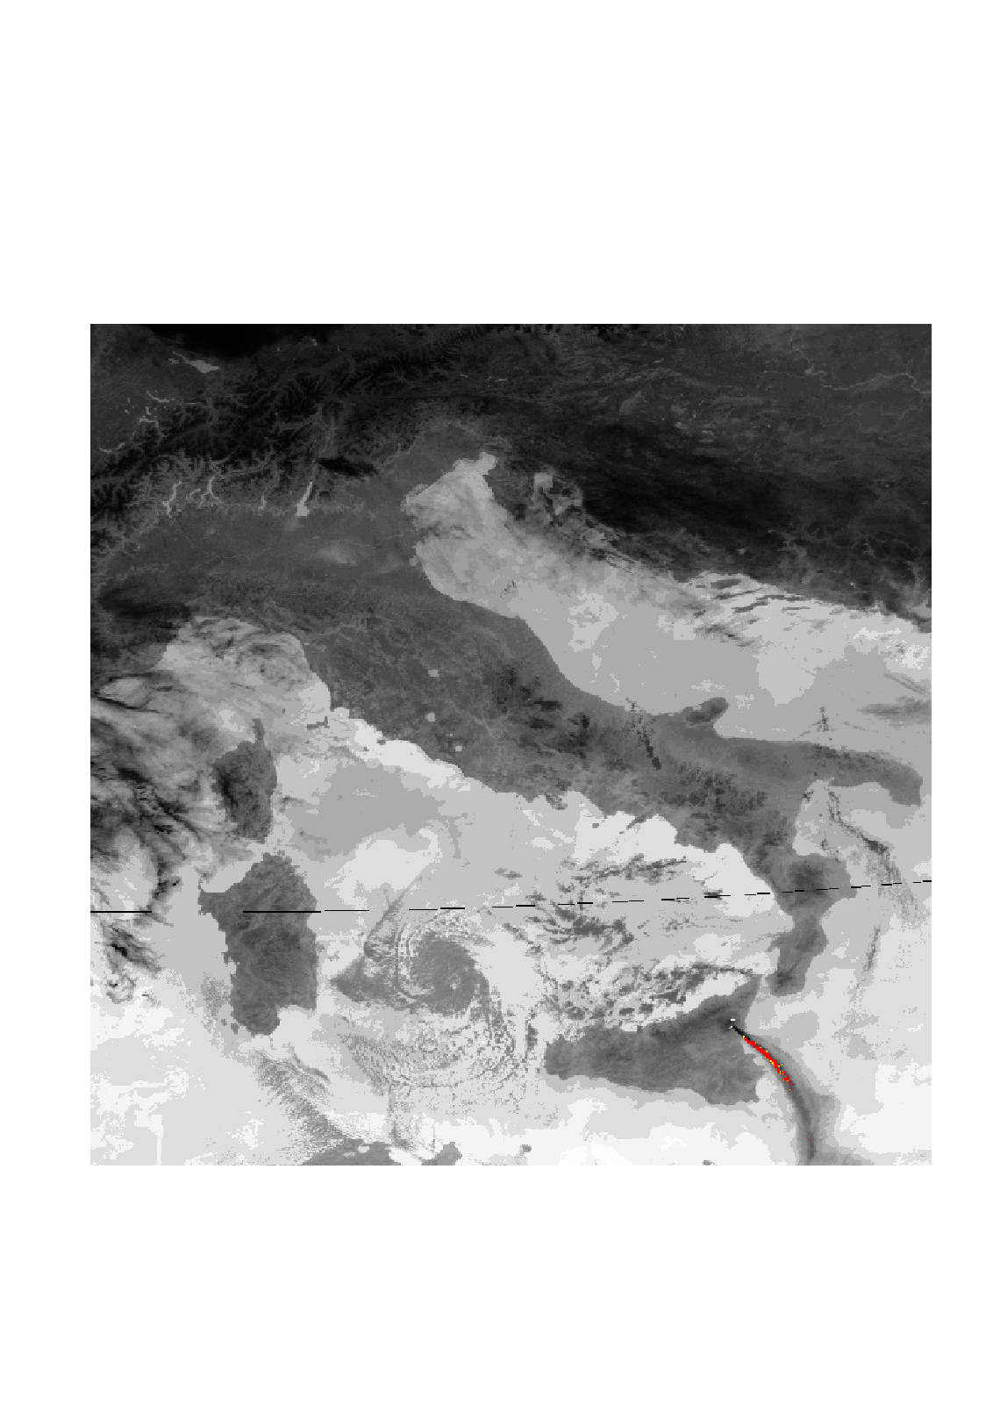
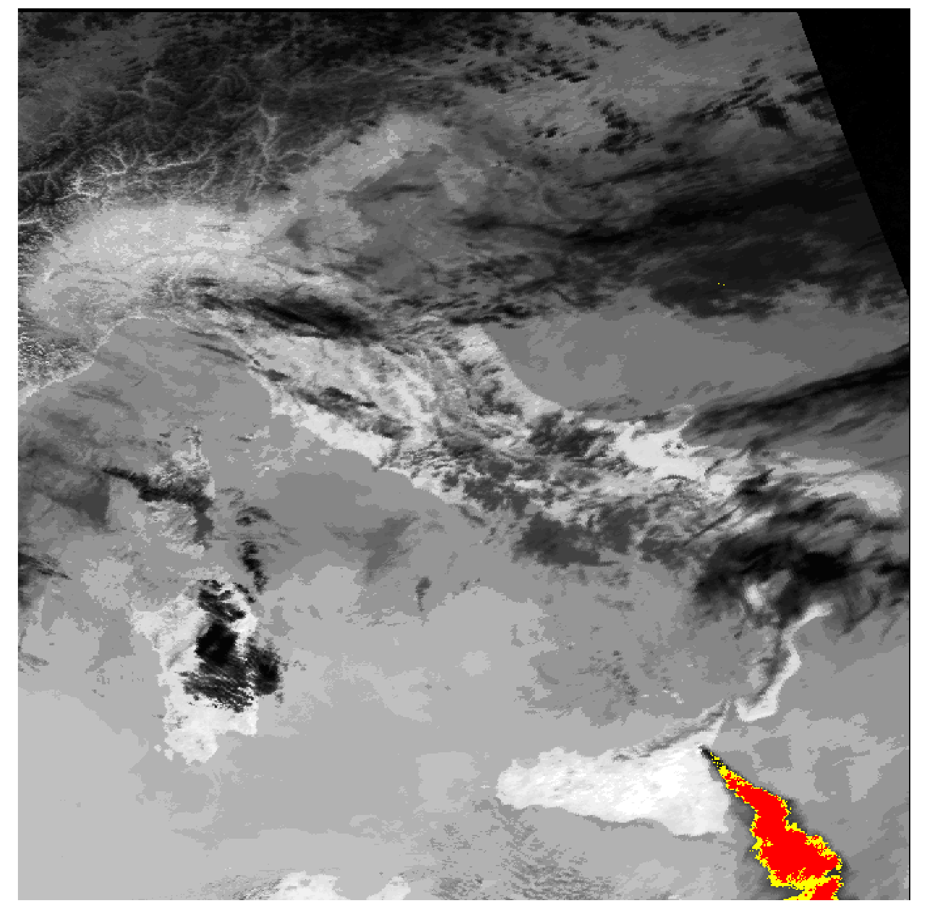
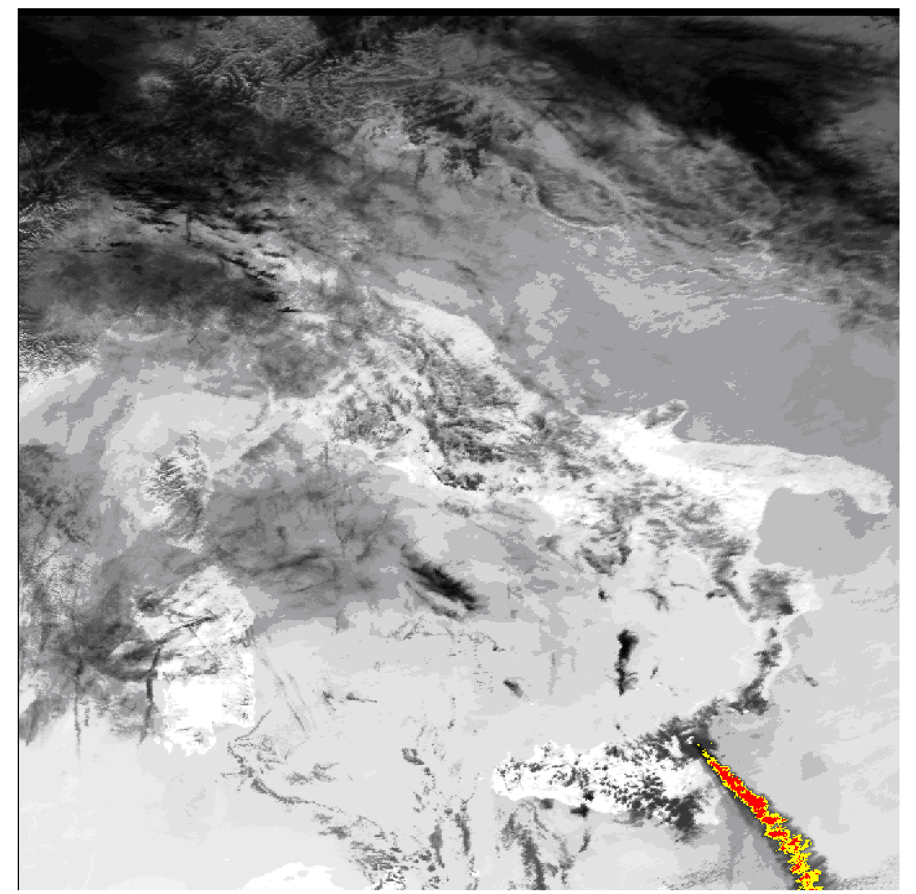
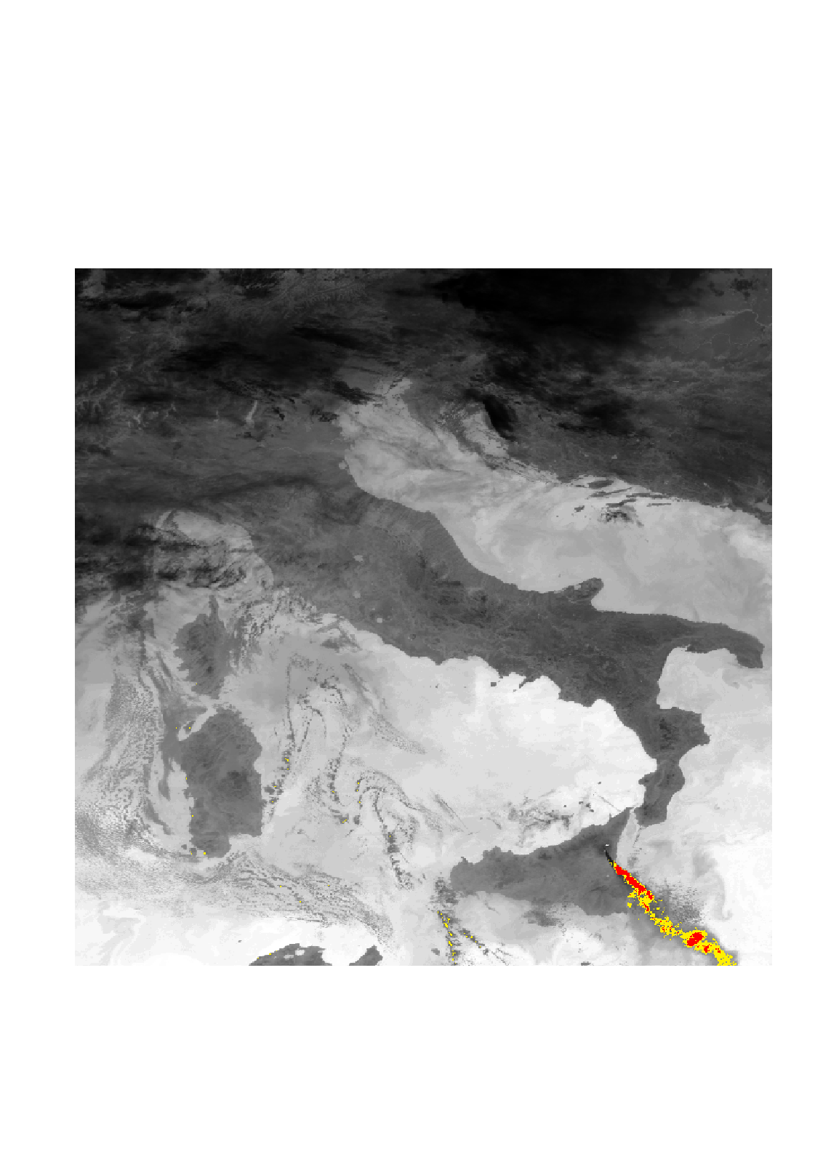
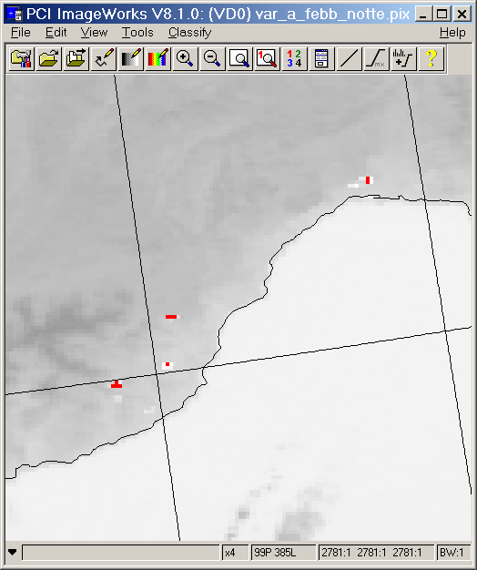
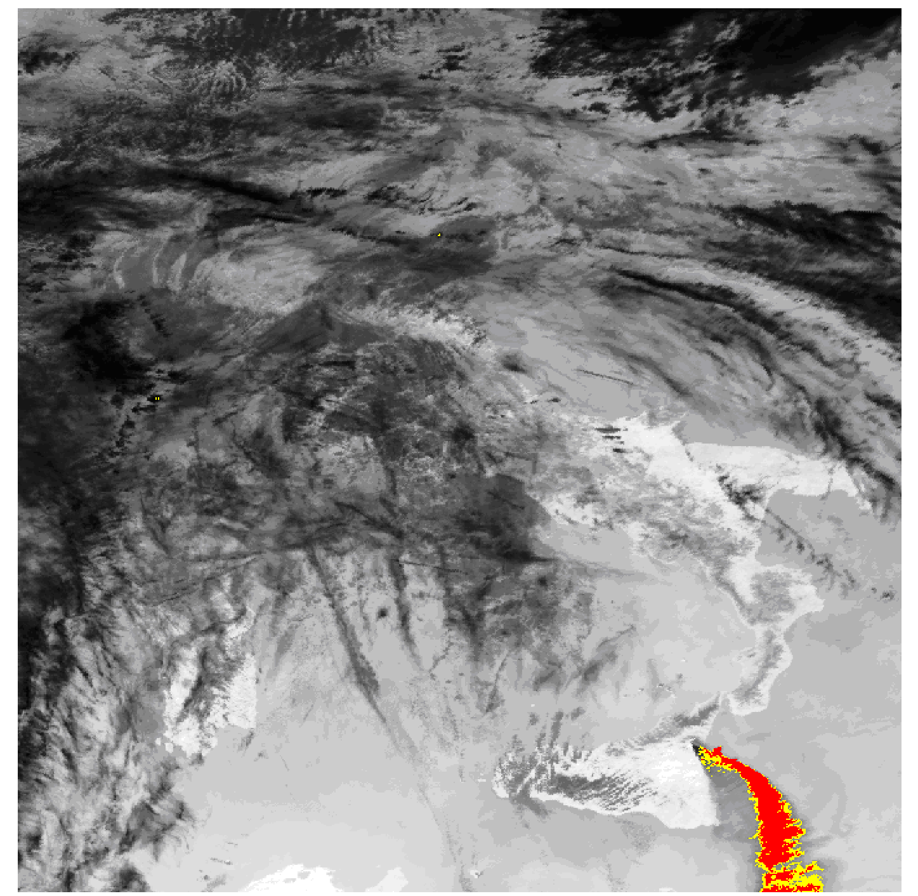
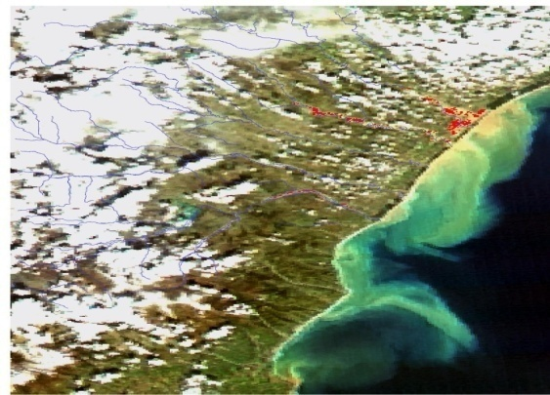
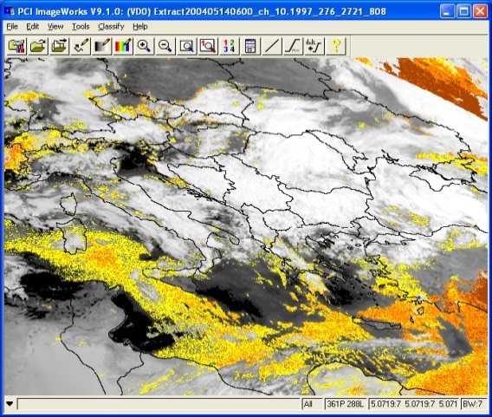
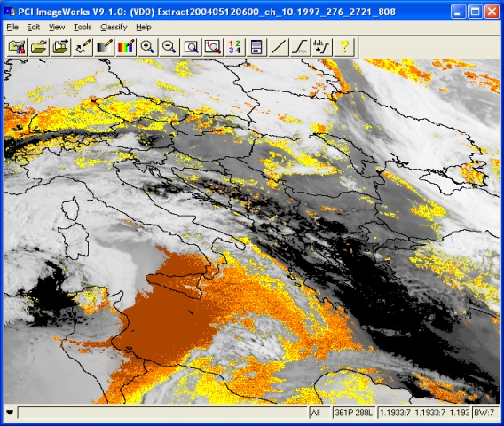
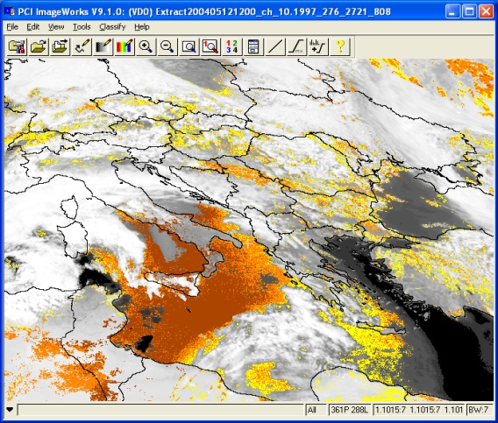
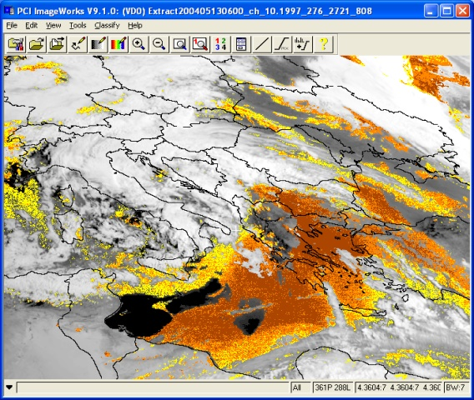
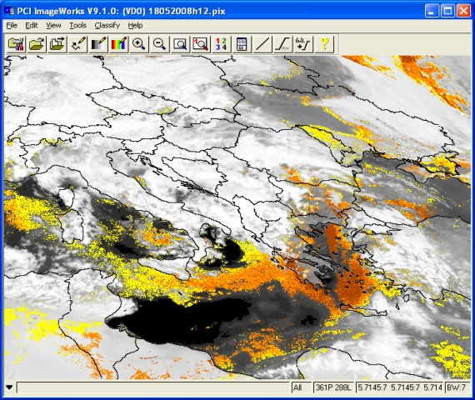
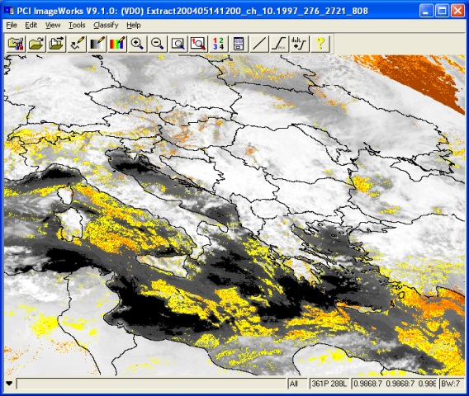

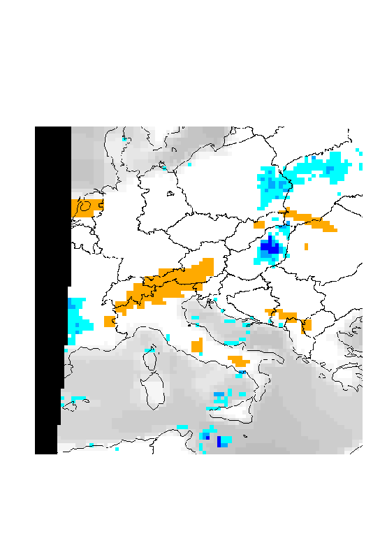
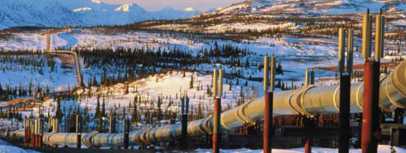
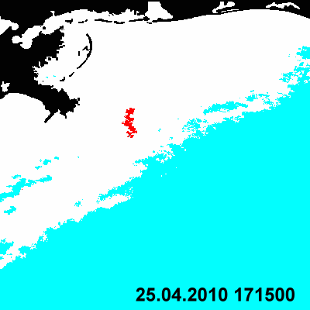
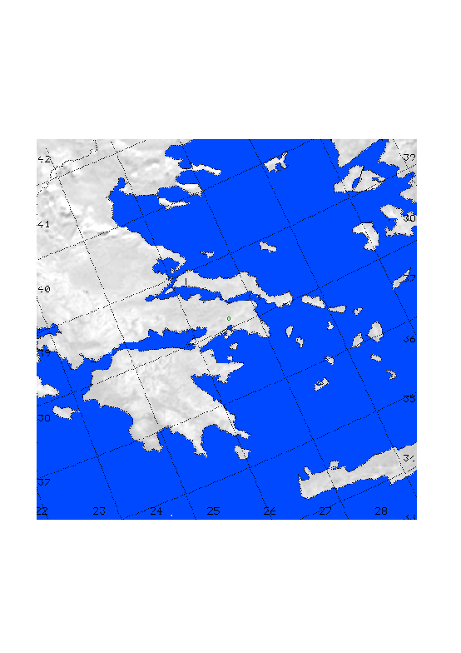
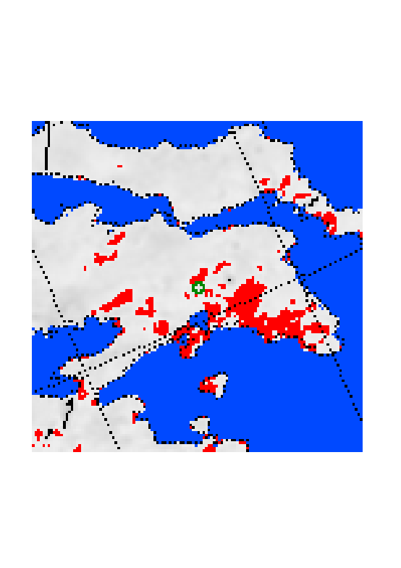


20 years of RST Applications
Forest fires
Volcanic Eruptions
Floods
Dust storms
e.g. Fires in Italy, February 2005
e.g. Etna eruption Oct 2002
e.g. Basilicata flood, March 2011
e.g.Libia 13 May 2004
Voltri
Erli
Casanova Lerrone
Carpasio
fires
Ash Clouds
Flooded areas
Dust clouds
Oil spills
Soil wetness
Earthquakes
Infrastructures
e.g. Oil spill in the Mexico Gulf, April 2010
e.g. Carpathian Basin, April 2000
e.g. 7 September 1999 Athens Earthquake
e.g. 18 October 2005 IRAQ
3 days before EQ
Deepwater Horizon Location
Raining Clouds
Weakly wet
Moderately wet
Oil spill
Extremely wet
Thermal anomalies
Explosions

Slide 19

Dust Storm Detection by RST
Compared with the background in (normal) clear-sky conditions both meteorological and dust clouds are characterized by:
higher VIS reflectance
SAND
STORM
METEO
CLOUDS
DESERT
BACKland
AVHRR VIS

Slide 20
Dust Storm Detection by RST
Compared with the background in (normal) clear-sky conditions both meteorological and dust clouds are characterized by:
higher VIS reflectance
METEO
CLOUDS
lower brightness temperatures
METEO
CLOUDS
Notes:
20

Slide 21
Dust Storm Detection by RST
Compared with the background in (normal) clear-sky conditions both meteorological and dust clouds are characterized by:
higher VIS reflectance
lower brightness temperatures
T_{11μ} - T_{12μ}< 0
T_{11μ} - T_{12μ}> 0
but they can be discriminated
by using the BTD signature ΔT= T_{11μ} - T_{12μ}
Notes:
21

Slide 22
Dust Storm Detection by RST
(RST_{DUST} Sannazzaro et al., Acta Astronautica93(2014) 64–70)
&
Detecting Clouds
&
Discriminating dust-clouds from meteorological clouds

Slide 23
RST_{DUST} application to the event of May 2008:
comparison with fixed threshold methods
and
with independent aerosol products (validation)

Slide 24


Saharan dust event of 18-23 May 2008
During 18-23 May 2008 a massive Saharan dust load coming from Algeria and Tunisia moved towards Europe diffusing over Greece.
On 18 May, Italy and Central Europe were the regions more affected by dust.
From 19 May also the Eastern Europe was involved by dust.
On 20 May the Saharan dust event was more intense over Greece, where it reached a value of dust loading estimated at around 0.75 g/m² (Amiridis, et al., 2009).

Slide 25


SEVIRI satellite data
Spinning Enhanced Visible and InfraRed Imager (SEVIRI) is on board the Meteosat Second Generation (MSG) platform
Repeat cycle: 15 min
Spatial resolution (sub-satellite point): 3×3 Km² (1×1 Km² HRV)

Slide 26
















Space-time evolution of dust outbreak of 18-23 May 2008 detected by RST_{DUST} on SEVIRI data
18/05/2008 00:00 GMT
18/05/2008 06:00 GMT
18/05/2008 12:00 GMT
19/05/2008 00:00 GMT
19/05/2008 06:00 GMT
50°
50°
50°
50°
50°
40°
40°
40°
40°
40°
10°
20°
10°
20°
10°
20°
10°
20°
10°
20°
20/05/2008 00:00 GMT
20/05/2008 12:00 GMT
21/05/2008 00:00 GMT
21/05/2008 06:00 GMT
21/05/2008 12:00 GMT
50°
50°
50°
50°
50°
40°
40°
40°
40°
40°
10°
20°
10°
20°
10°
20°
10°
20°
10°
20°
22/05/2008 00:00 GMT
22/05/2008 06:00 GMT
22/05/2008 12:00 GMT
23/05/2008 00:00 GMT
23/05/2008 06:00 GMT
50°
50°
50°
50°
50°
40°
40°
40°
40°
40°
10°
20°
10°
20°
10°
20°
10°
20°
10°
20°
23/05/2008 12:00 GMT
50°
RST-DUST maps reporting dynamic evolution (at six hours) of dust event which affected Mediterranean basin in May 2008
40°
probability of dust presence in the atmosphere
10°
20°

Slide 27




Comparison with fixed-threshold methods
19/05/2008 06:00 UTC
Gu et al. (2003)
Luo et al. (2003)
RST_{DUST}
OMI Aerosol index indicates the presence of dust
ΔT < -0.5k
T11 μm >290K & T12 μm >290k & ΔT ≤ 1K
probability of dust presence in the atmosphere
POTENZA EARLINET station indicates the presence of dust
EARLINET stations

Slide 28


Comparison with independent satellite-based aerosol products
19/05/2008 at 09:15 UTC
RST_{DUST}
Terra-MODIS AOD product
(10 km spatial resolution)
probability of dust presence in the atmosphere
http://ladsweb.nascom.nasa.gov/data/search.html

Slide 29




Assessment of RST_{DUST} products by means of ground-based lidar profiles (EARLINET data)
30°
19/05/2008 at 09:30 UTC
50°
Sofia: 43.65 N, 23.38 E
40°
10°
20°
probability of dust presence in the atmosphere
Potenza: 40.6 N, 15.72 E
Naples: 40.83 N, 14.18 E

Slide 30




Assessment of RST_{DUST} products by means of CALIOP (Cloud-Aerosol Lidar with Orthogonal Polarization) data
RST-DUST 22/05/2008 at 11:30 UTC
probability of dust presence in the atmosphere
http://www-calipso.larc.nasa.gov/products/lidar/browse_images/production/

Slide 31
Integration of the RST_{DUST} satellite products and PM₁₀ ground measurements

Slide 32


Satellite and ground data used
PM₁₀ concentrations from ARPAB (Regional Environment Protection Agency of Basilicata) air quality monitoring ground stations
MSG-SEVIRI

Slide 33







Time series of ARPAB ground PM₁₀ concentrations
_{May 2006-2012}
Bihourly measurement: air monitoring stations in Rossellino, V. Unicef, V. Firenze, Melfi, S. Nicola-Melfi
Daily measurement: air monitoring station in Viggiano
May 2006 – PM₁₀
May 2008 – PM₁₀
May 2011 – PM₁₀
May 2010 – PM₁₀
May 2012 – PM₁₀
May 2007 – PM₁₀
May 2009 – PM₁₀

Slide 34

PM₁₀ exceedances (May 2006, May 2008)
Regulatory limit (*)
Exceedance day | Monitoring station | PM₁₀ concentrations [μg/m³]
23 May 2006 | Rossellino | 51,326
23 May 2006 | V. Unicef | 74,052
24 May 2006 | Rossellino | 63,008
24 May 2006 | V. Unicef | 67,684
19 May 2008 | V. Firenze | 55,516
27 May 2008 | Rossellino | 55,082
*Daily limit 50 μg/m³ (Dir 2008/50/CE)

Slide 35




Quantifying natural contribution in PM₁₀ (EC, 2011)
Methodology for the determination of re-suspended and transported Saharan dust
1. Identifying Saharan dust outbreak episodes (EC, 2011, suggests consultation of products such as dust-forecast models)
19/05/2008
27/05/2008
The use of RST_{DUST} product instead of forecast maps is expected to increase reliability of dust events detection
Exceedance day | Monitoring station | PM₁₀ concentrations [μg/m³]
23 May 2006 | Rossellino | 51,326
23 May 2006 | V. Unicef | 74,052
24 May 2006 | Rossellino | 63,008
24 May 2006 | V. Unicef | 67,684
19 May 2008 | V. Firenze | 55,516
27 May 2008 | Rossellino | 55,082
EC (2011) - COMMISSION STAFF WORKING PAPER establishing guidelines for demonstration and subtraction of exceedances attributable to natural sources under the Directive 2008/50/EC on ambient air quality and cleaner air for Europe

Slide 36

Quantifying natural contribution in PM₁₀ (EC, 2011)
Methodology for the determination of re-suspended and transported Saharan dust
1. Identifying Saharan dust outbreak episodes
2. Quantifying Saharan dust outbreak episodes
Monitoring station in Melfi
Identification of the regional background station

Slide 37
















Quantifying natural contribution in PM₁₀ (EC, 2011)
Methodology for the determination of re-suspended and transported Saharan dust
1. Identifying Saharan dust outbreak episodes
02 May 2006 ore 06 GMT
06 May 2006 ore 06 GMT
07 May 2006 ore 06 GMT
02 May 2006 ore 12 GMT
08 May 2006 ore 06 GMT
25 May 2006 ore 12 GMT
12 May 2006 ore 12 GMT
30 May 2006 ore 12 GMT
2. Quantifying Saharan dust outbreak episodes
Dust events in background station (identified by means of RST_{DUST})
Computation of the regional background level:
in each time series of the regional background station, the monthly moving percentile 40 is determined for each day, excluding days with identified African influence.
23 May 2008 ore 12 GMT
02 May 2008 ore 12 GMT
29 May 2008 ore 06 GMT
19 May 2008 ore 06 GMT
11 May 2008 ore 06 GMT
22 May 2008 ore 12 GMT
28 May 2008 ore 12 GMT
26 May 2008 ore 06 GMT
27 May 2008 ore 06 GMT

Slide 38







PM₁₀ anomalies under exceedance limit
No PM₁₀ threshold value has been identified below which there is NO observed damage to health
Importance of anomalous PM₁₀ concentrations even if regulatory daily limit is not exceeded
RST approach to identify anomalous PM₁₀ values
ALICE May 2006
ALICE May 2007
ALICE May 2008
ALICE May 2012
ALICE May 2011
ALICE May 2010
ALICE May 2009

Slide 39

PM₁₀ anomalies under exceedance limit
E.g. Rossellino monitoring station
PM₁₀ concentration – May 2008
Over-threshold
(>50μg/m³) PM₁₀ concentrations (due to dust contribution)
ALICE PM₁₀ – May 2008
Under-threshold
(<50μg/m³) PM₁₀ concentrations (due to dust contribution)
ALICE
Under-threshold
(<50μg/m³) PM₁₀ concentrations (probably due to anthropogenic contribution)

Slide 40
Conclusions
The RST_{DUST} algorithm guarantees, in comparison with fixed threshold methodologies, improved performances both in terms of reliability (very low rate of false positives) and sensitivity (lower rate of missed identifications);
Being based only on satellite data at hand, RST_{DUST} is intrinsically exportable on whatever satellite sensor having VISible and TIR split-window capabilities
To quantify dust contribution, RST_{DUST} maps were used instead of forecast maps, as suggested by EC. This permitted us to recognize dust outbreaks with greater reliability
The RST application to ground PM₁₀ time-series permits us to identify anomalous PM₁₀ concentrations under exceedance limit. The comparison with RST_{DUST} products allows to evaluate the source of such under-threshold anomalies (natural or anthropogenic source).

Slide 41
Airborne dust identification from space: a new, MSG/SEVIRI-based method for air quality assessment (valerio.tramutoli@unibas.it) ^{Main References:} Marchese, F., F. Sannazzaro, A. Falconieri, C. Filizzola, N. Pergola, and V. Tramutoli (2017), An enhanced satellite-based algorithm for detecting and tracking dust outbreaks by means of SEVIRI data, Remote Sens., 9(6), 1–24, doi:10.3390/rs9060537. Sannazzaro F, Pergola N, Corrado R, Filizzola C, Marchese F, Mazzeo G, Paciello R, Tramutoli V (2014). A New Approach for Detecting and Monitoring Saharan Dusts from Space. Geoinformatics & Geostatistics: An Overview S1. doi:10.4172/2327-4581.S1-019 Sannazzaro F, Filizzola C, Marchese F, Corrado R, Paciello R, Mazzeo G, Pergola N, Tramutoli V, (2013). Identification of dust outbreaks on infrared msg-seviri data by using a Robust Satellite Technique (RST). Acta Astronautica (ISSN:0094-5765). 93, pp. 64- 70.
Thank you

